Slide 1
IT Solutions
Brett Waddell, Sydney Kittiekaywinnie, Sonja Eninew, Allen Pambrun

Slide 2
Introduction
Overview
Network Sketch
Network Map
IP Addressing Scheme
Prepare Equipment

Slide 3
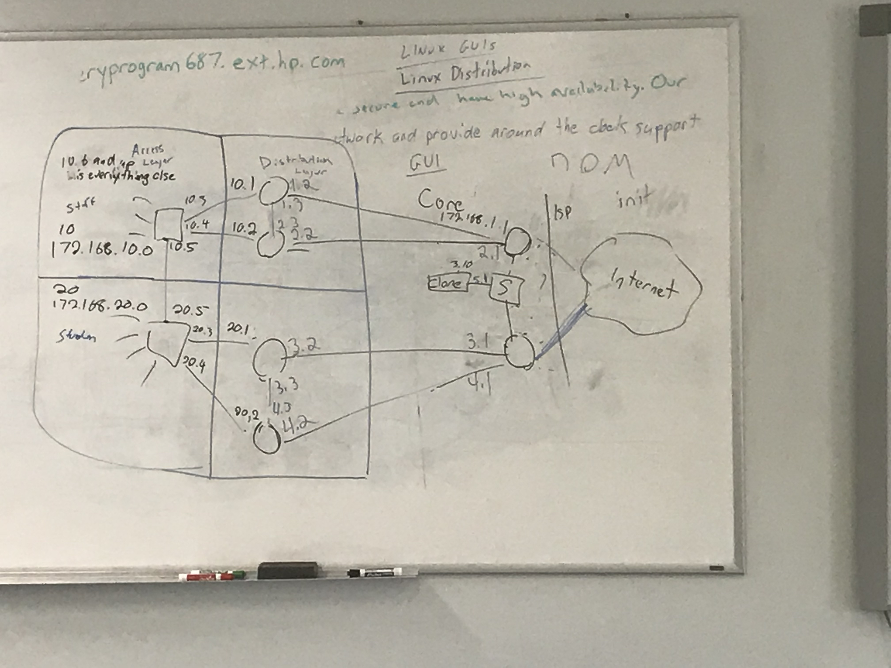
Network sketch
We created the network sketch to give us a general idea for what we want our network to look like
We needed to know how to connect the devices together so that connectivity was possible

Slide 4
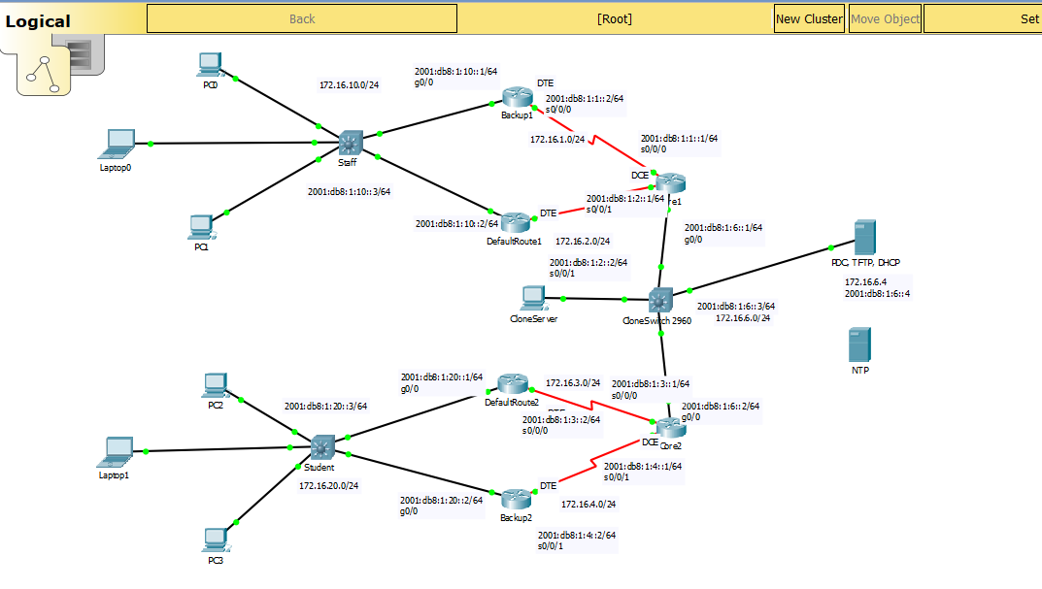
Network map
Packet Tracer was used to create the network in a virtual environment
Implementing OSPF and VLANS for testing purposes
Verify connectivity without the physical aspect

Slide 5
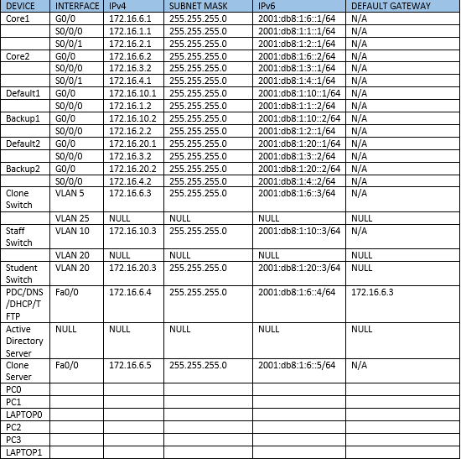
Addressing scheme

Slide 6
troubleshooting
We forgot to add IPv6 to our IP addressing scheme
We had to revise topology to not include a fourth switch
We didn’t configure trunking properly, no communication between switches
We needed to put the sdm prefer dual-ipv4-and-ipv6 default command on the switches
Forgot to set the default gateway of the DNS/PDC/DHCP server to 172.16.6.3
Can’t communicate between switches and routers

Slide 7
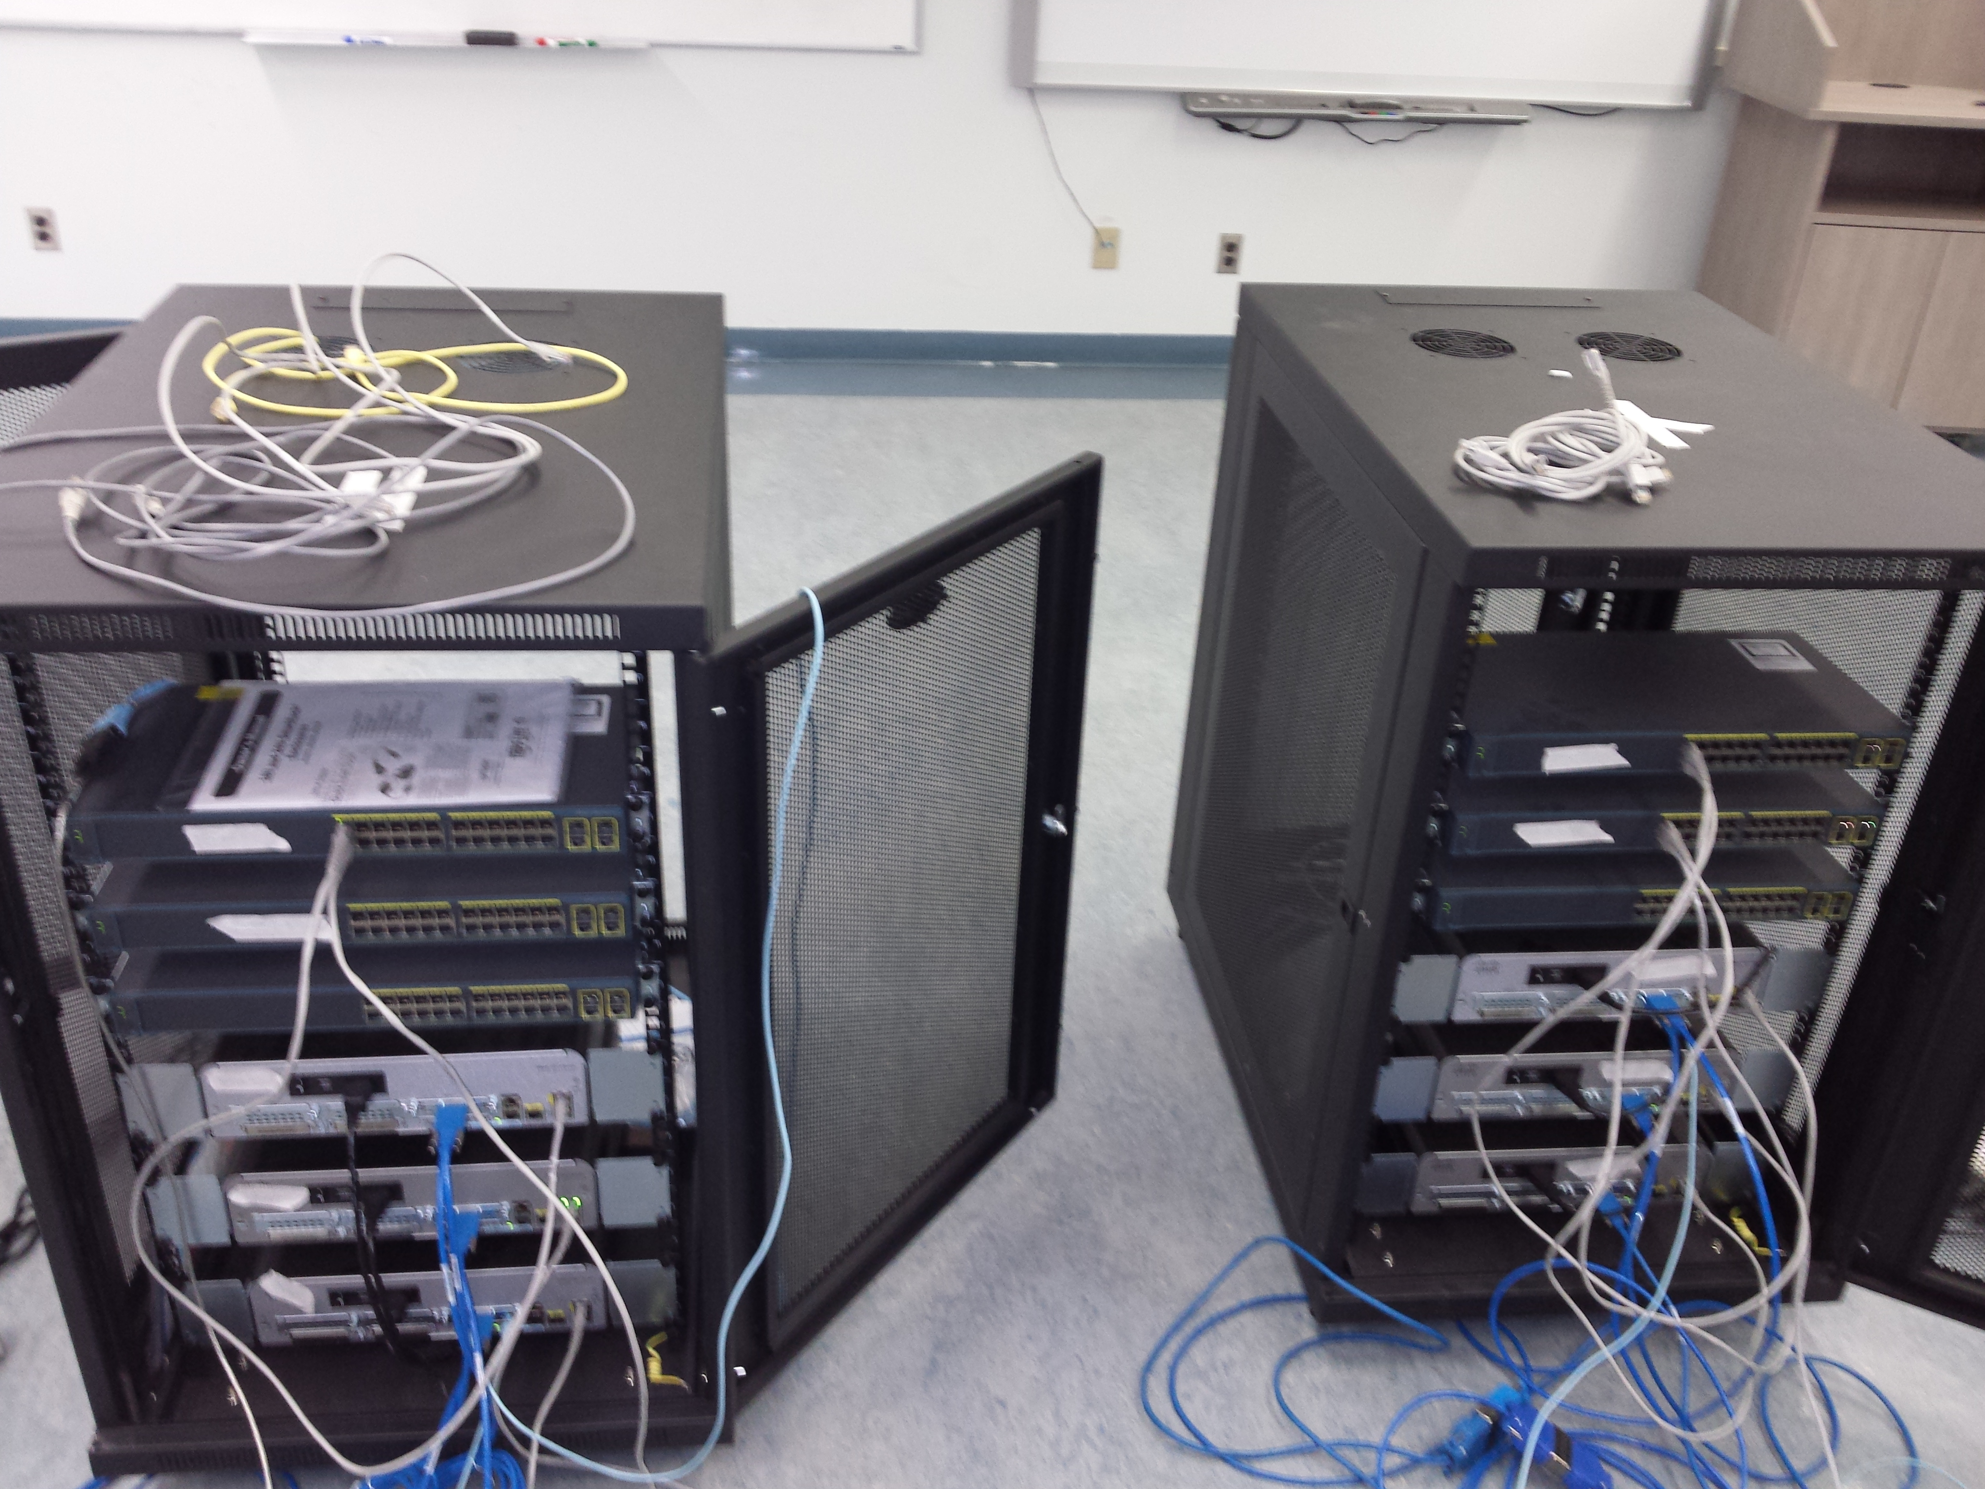
Preparing the equipment
Cleared the configuration on the routers and switches
Connected the cables according to the topology from Packet Tracer
Configured the Hostname
Configured passwords on all the devices

Slide 8
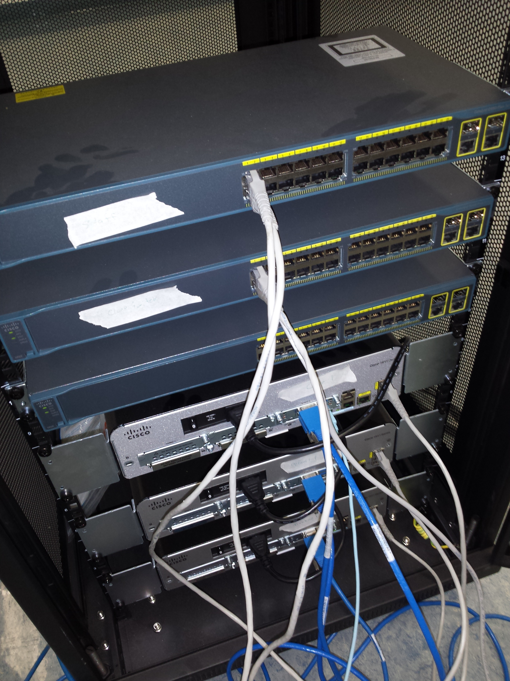
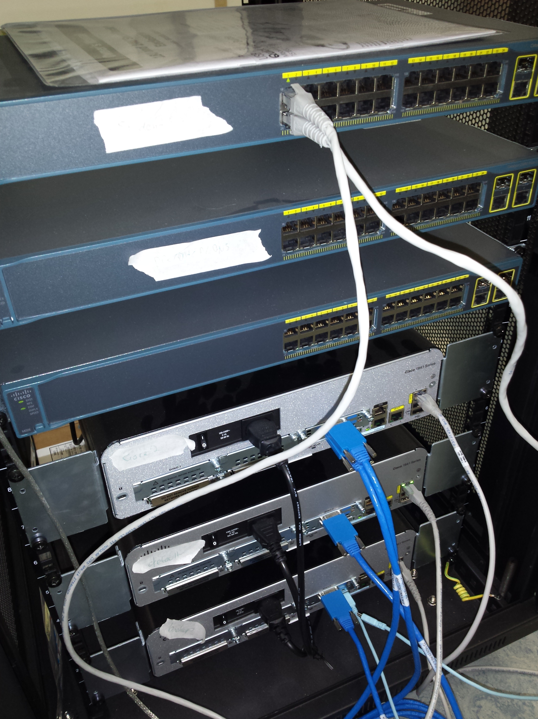
Continued.....

Slide 9
Up next
Configure default routes
Create banner messages (MOTD)
Set up password encryption
Configure the IP addressing scheme
Activate the interfaces
Set up clock rate

Slide 10
QUESTIONS?

